Slide 1
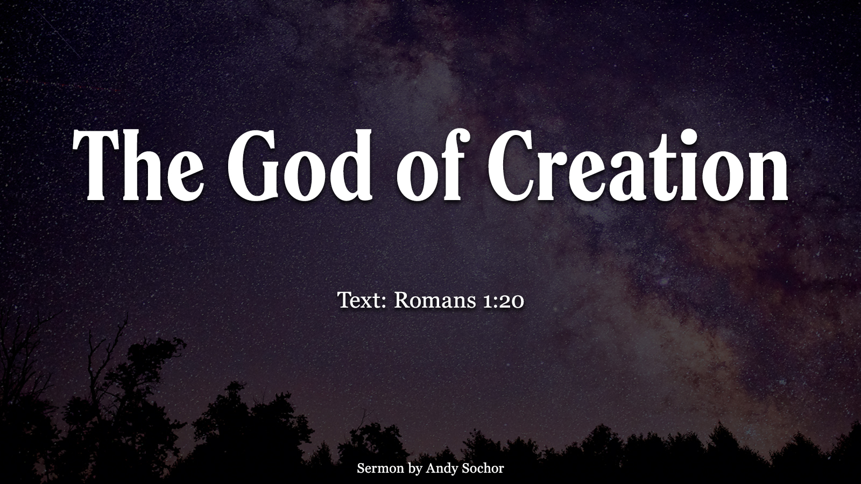

Slide 2
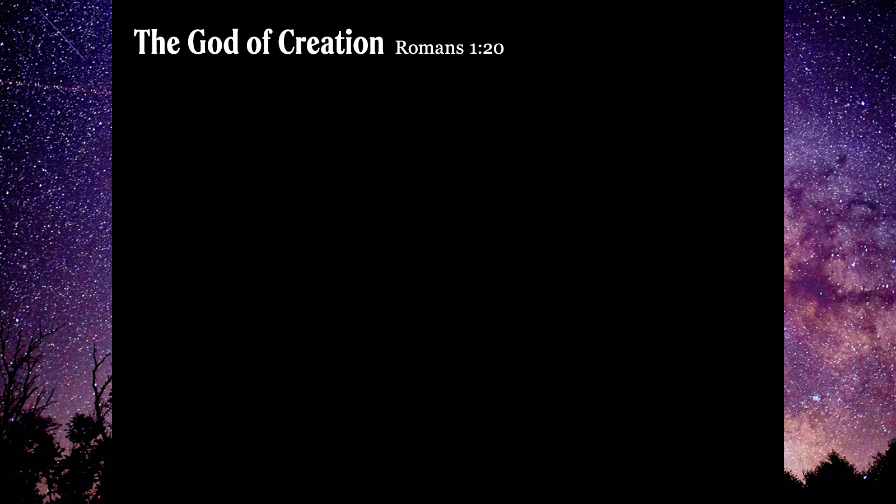
Understanding God through Creation
God pre-existed all things (Gen. 1:1) – builder of all things (Heb. 3:4); eternal (Ps. 90:2)
God has power over all things (Rom. 1:20) – authority over the world (Col. 1:16-17); power over life and death (James 4:12)
God has a plan for what He does (Gen. 1) – His word is settled (Ps. 119:89) and consistent (Jn. 10:35)
God made all things for our good (Gen. 1:31) – under man’s stewardship (Gen. 1:29); everything good in this life is from Him (James 1:17)

Slide 3
What Does This Mean for Us?
If God pre-existed all things, then there is something beyond this life (2 Pet. 3:7, 13)
If God has power over all things, then we need to humble ourselves before Him (1 Pet. 5:6)
If God has a plan for what He does, then we need to trust Him and submit to His will (Eccl. 12:13; Jn. 2:5)
If God made all things for our good, then we need to show gratitude (1 Tim. 4:4-5)

